Slide 1
Organizational Structure

Slide 2
Identify the factors that influence managers’ choice of an organizational structure
Explain how managers group tasks into jobs that are motivating and satisfying for employees
Describe the types of organizational structures managers can design, and explain why they choose one structure over another
Explain why managers must coordinate jobs, functions, and divisions using the hierarchy of authority and integrating mechanisms

Slide 3
Designing Organizational Structure
Organizational structure: Formal system of task and reporting relationships that coordinates and motivates organizational members so that they work together to achieve organizational goals
Organizational design: Process by which managers make specific organizing choices that result in a particular kind of organizational structure

Slide 4
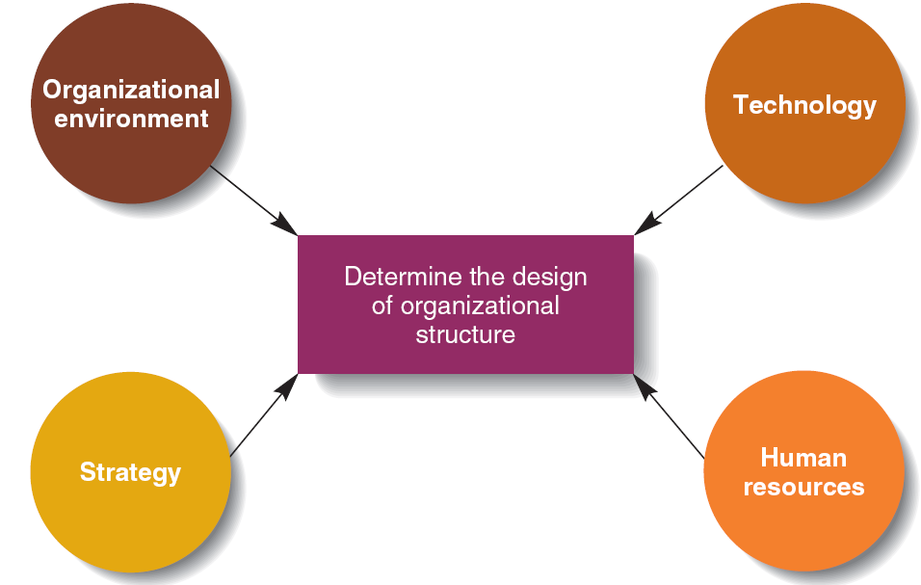
Figure 7.1 - Factors Affecting Organizational Structure

Slide 5
Grouping Tasks into Jobs
Job design: Managers decide how to divide tasks into specific jobs
Job simplification: Reducing the number of tasks that each worker performs
Job enlargement: Increasing the number of different tasks in a given job by changing the division of labor
Job enrichment: Increasing the degree of responsibility a worker has over a job

Slide 6
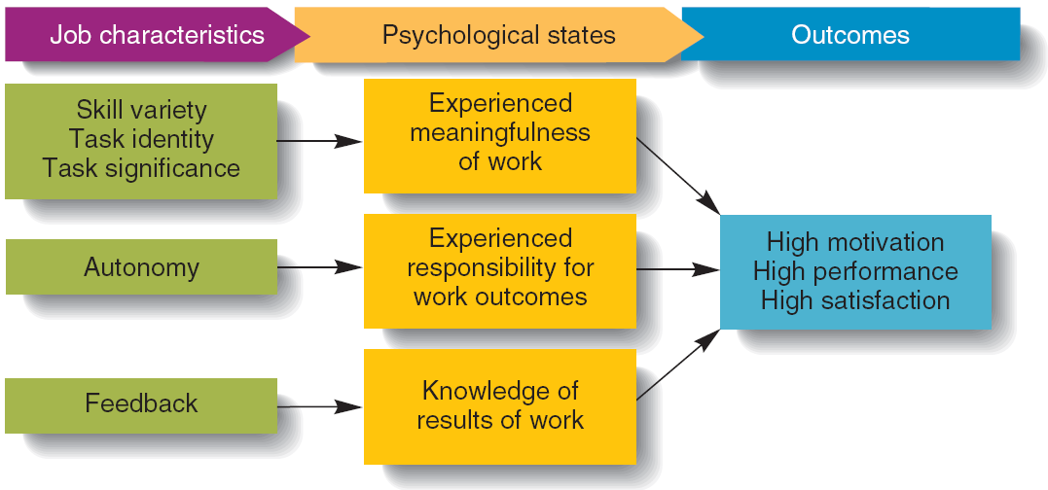
Figure 7.2 - The Job Characteristics Model

Slide 7
Grouping Jobs into Functions
Functional structure: An organizational structure composed of all the departments that an organization requires to produce its goods or services

Slide 8
Grouping Jobs into Functions
Advantages
Encourages learning from others doing similar jobs
Easy for managers to monitor and evaluate workers
Allows managers to scan, monitor and obtain information about the changing competitive environment
Disadvantages
Difficult for managers in different functions to communicate and coordinate with one another
Functional managers may become preoccupied in achieving their departmental goals that they lose sight of organizational goals

Slide 9
Divisional Structures
Organizational structure composed of separate business units within which are the functions that work together to produce a specific product for a specific customer
Product structure: Each product line or business is handled by a self-contained division

Slide 10
Product Structure
Advantages
Allows functional managers to specialize in one product area
Division managers become experts in their area
Removes need for direct supervision of the division by corporate managers
Divisional management improves the use of resources
Allows organization to be market and customer centred and aligned

Slide 11
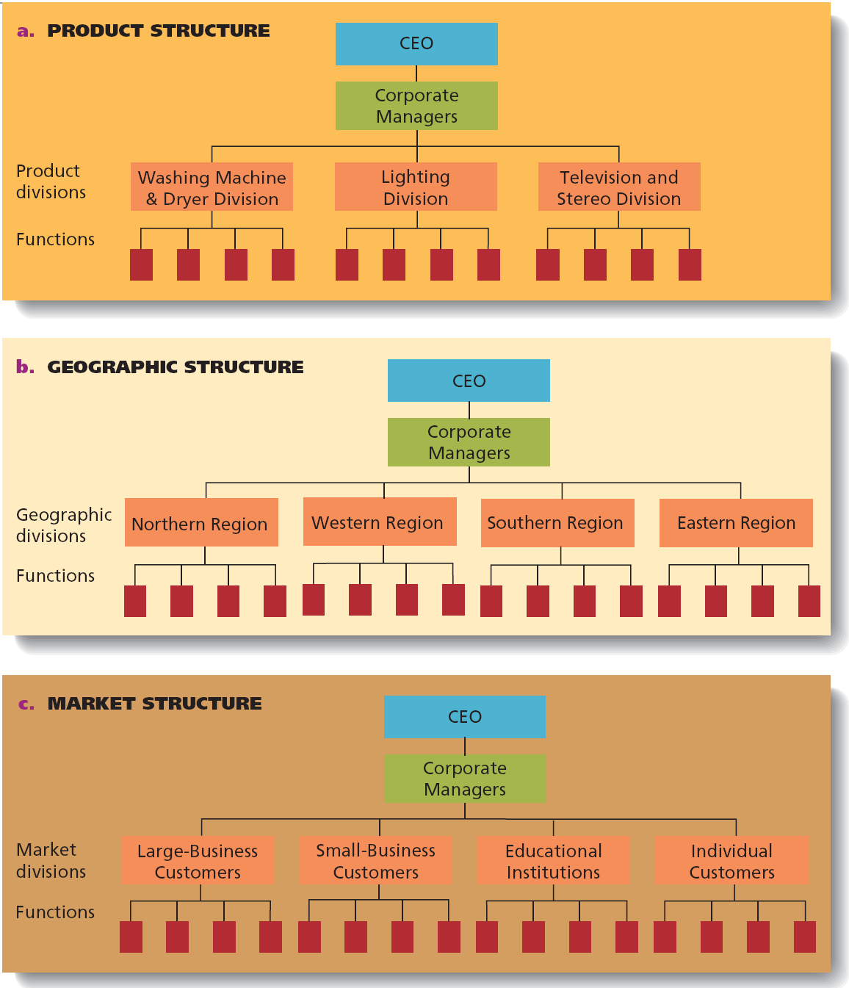
Figure 7.4 - Product, Market, and Geographic Structures

Slide 12
Geographic Structure and its Types
Geographic structure: Each region of a country or area of the world is served by a self-contained division
Global geographic structure
Managers locate different divisions in each of the world regions where the organization operates
Occurs when managers are pursuing a multi-domestic strategy (customization of products and markets)

Slide 13
Geographic Structure and its Types
Global product structure: Each product division, not the country or regional managers, takes responsibility for deciding where to manufacture its products and how to market them in foreign countries

Slide 14
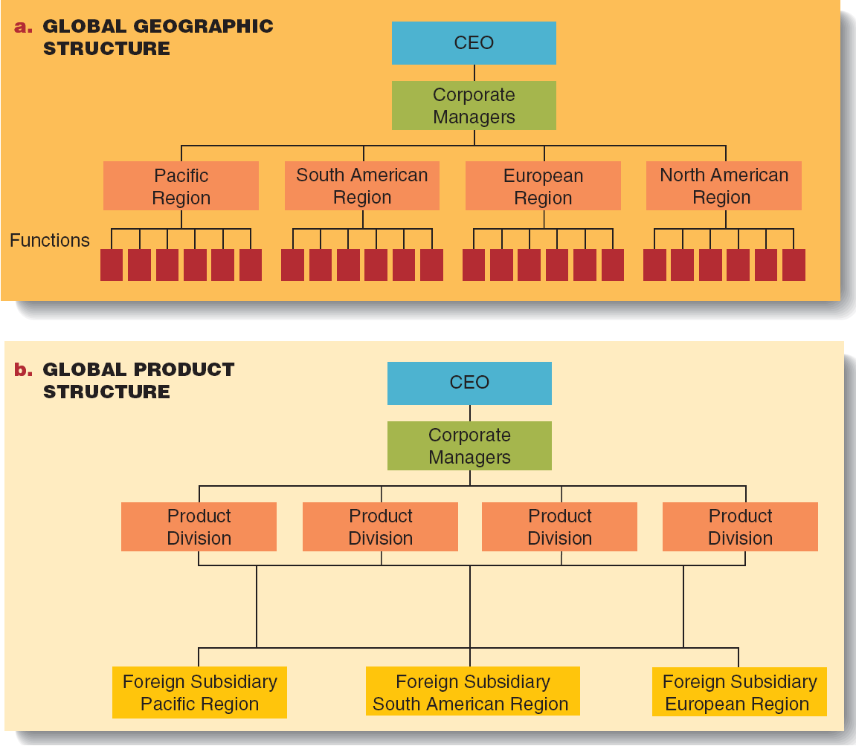
Figure 7.5 - Global Geographic and Global Product Structures

Slide 15
Market Structure
Market structure: Each kind of customer is served by a self-contained division; also called customer structure
Matrix structure: An organizational structure that simultaneously groups people and resources by function and product

Slide 16
Product Team Design Structure
Product team structure: Members are permanently assigned to a cross-functional team and report only to the product team manager or to one of his direct subordinates
Cross-functional team: Group of managers brought together from different departments to perform organizational tasks

Slide 17
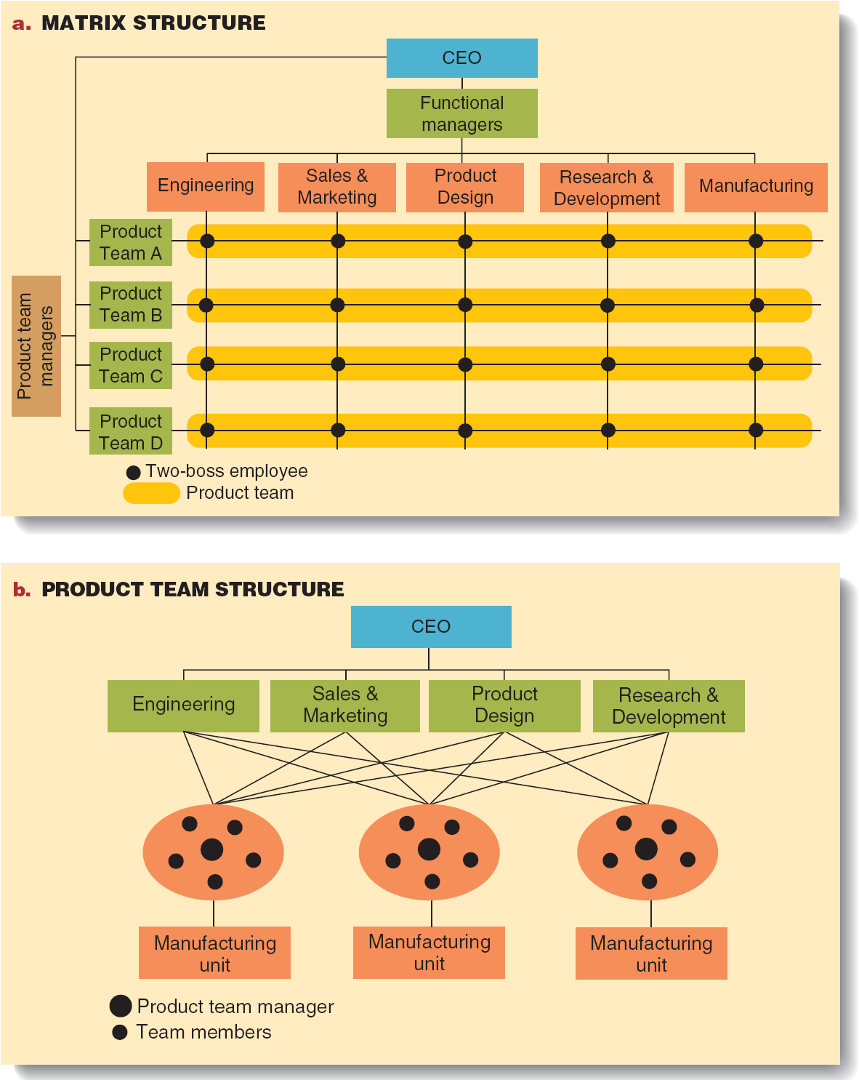
Figure 7.6 - Matrix and Product Team Structures

Slide 18
Coordinating Functions and Divisions
Authority: Power to hold people accountable for their actions and to make decisions concerning the use of organizational resources
Hierarchy of authority: Organization’s chain of command, specifying the relative authority of each manager

Slide 19
Allocating Authority
Span of control: The number of subordinates that report directly to a manager
Line manager: Someone in the direct line or chain of command who has formal authority over people and resources
Staff manager: Someone responsible for managing a specialist function, such as finance or marketing

Slide 20
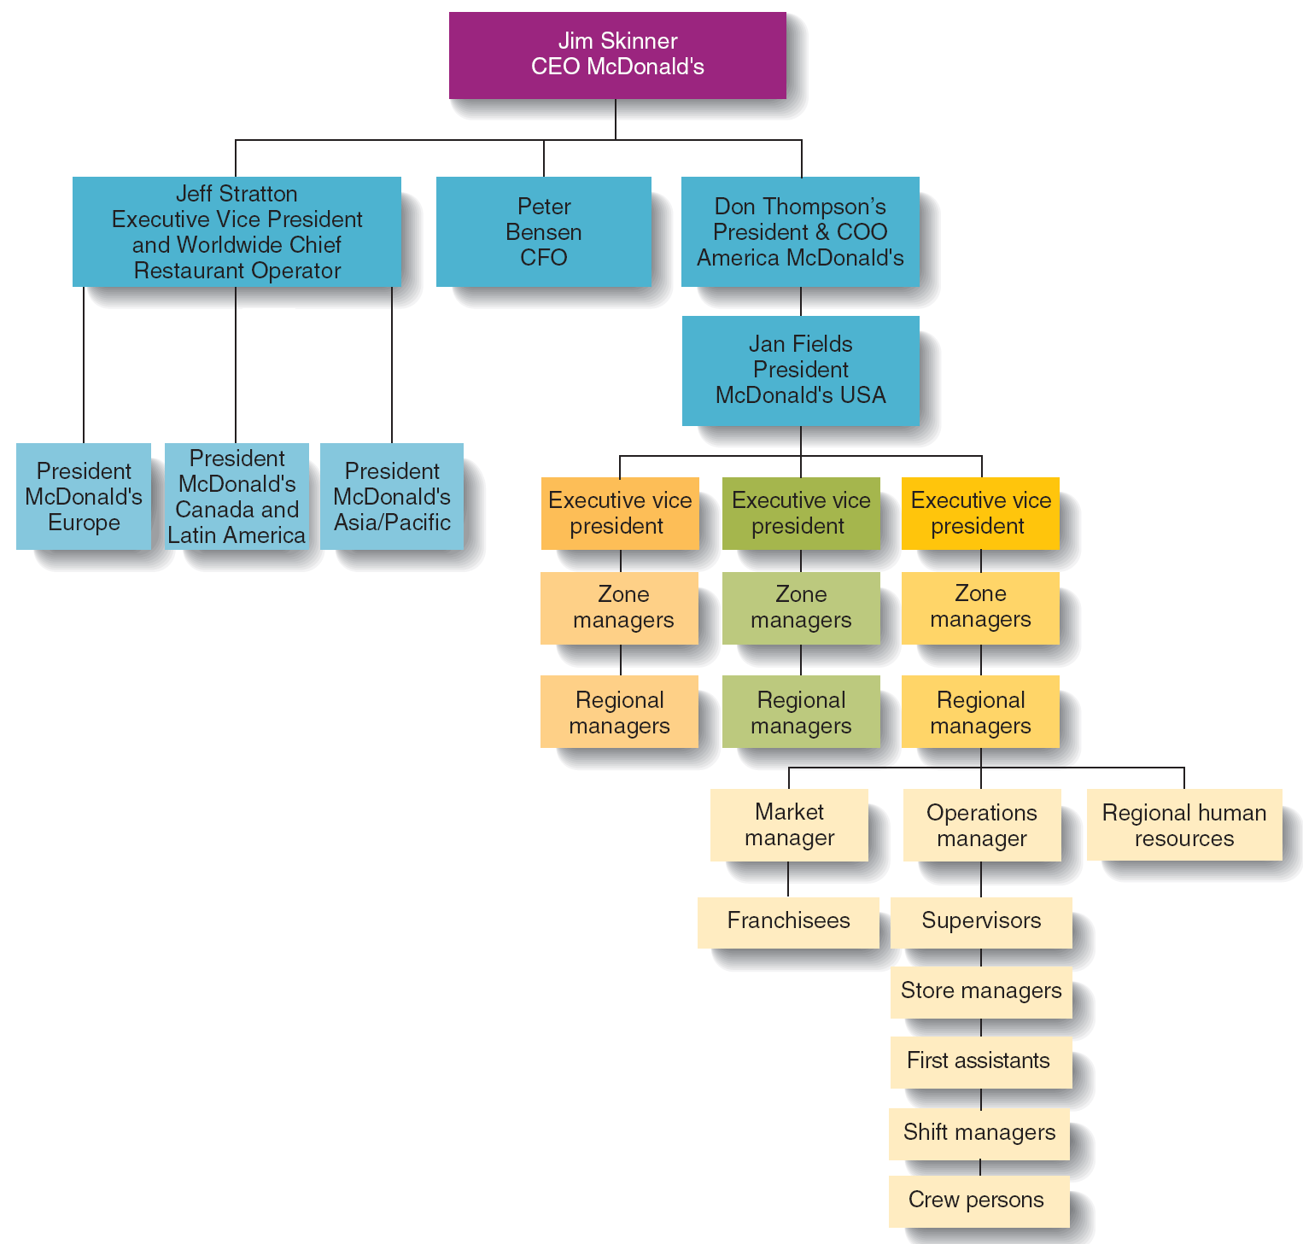
Figure 7.7 - The Hierarchy of Authority and Span of Control at McDonald’s Corporation

Slide 21
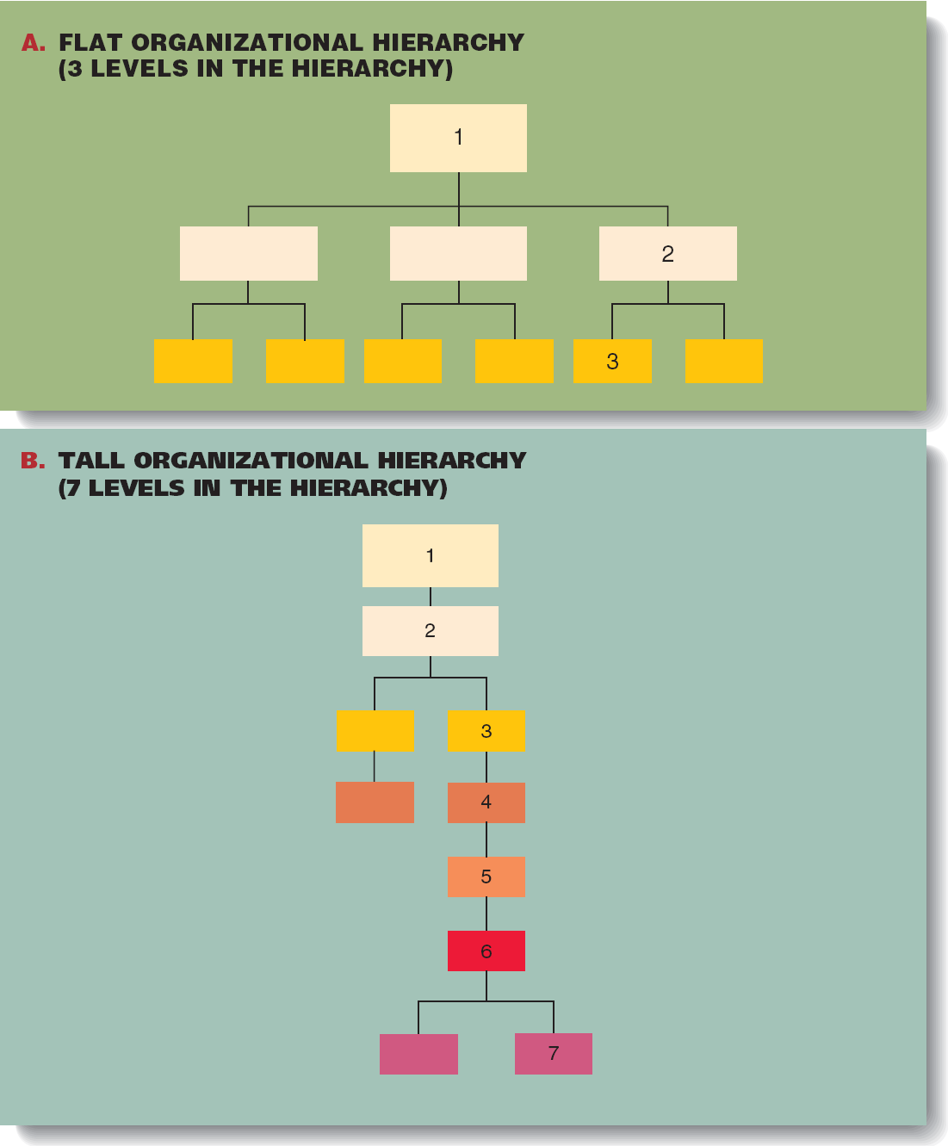
Figure 7.8 - Tall and Flat Organizations

Slide 22
Centralization and Decentralization of Authority
Top managers must seek the balance between centralization and decentralization of authority
Decentralizing authority: Giving lower-level managers and non-managerial employees the right to make important decisions about how to use organizational resources
Decentralized teams may begin to pursue their own goals at the expense of organizational goals

Slide 23
Integrating and Coordinating Mechanisms
Integrating mechanisms: Organizing tools that managers can use to increase communication and coordination among functions and divisions

Slide 24
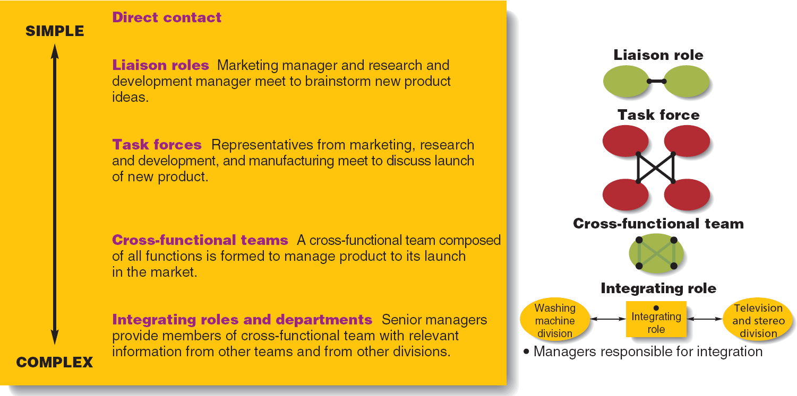
Figure 7.9 - Types and Examples of Integrating Mechanisms

Slide 25
Strategic Alliances, B2B Network Structures, and IT
Strategic alliance: An agreement in which managers pool or share firm’s resources and know-how with a foreign company and the two firms share in rewards and risks of starting a new venture
Network structure: Series of strategic alliances that an organization creates with suppliers, manufacturers, and distributors to produce and market a product
It allows firms to bring resources together in a boundary-less organization
E.g. Lands’ End Case: B2B Buy Committee & Centre

Slide 26
Strategic Alliances, B2B Network Structures, and IT
Outsource: To use outside suppliers and manufacturers to produce goods and services
Boundaryless organization: Members are linked by computers, faxes, computer-aided design systems, and video-conferencing and who, rarely, if ever, see one another face-to-face
Knowledge management system: Company-specific virtual information system that allows workers to share their knowledge and expertise and find others to help solve problems

Slide 27
Strategic Alliances, B2B Network Structures, and IT
Business to Business (B2B ) network: Group of organizations that join together and use IT to link themselves to potential global suppliers to increase efficiency and effectiveness
Lands’ End Case: B2B Buy Committee, Buy Centre

